Slide 1



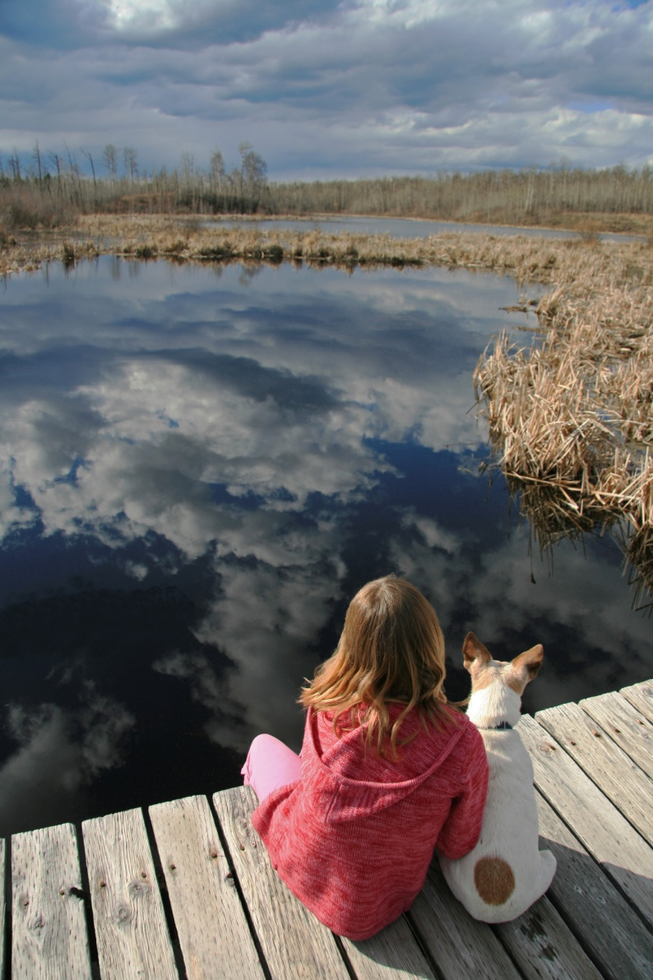
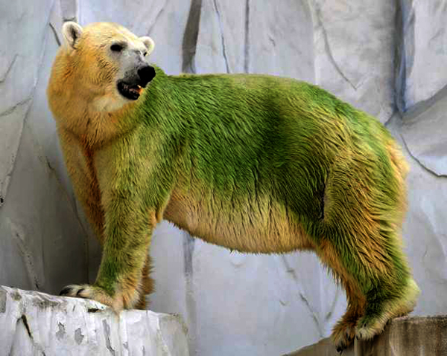
Water 101
Harmful Algae Blooms
Oregon Public Health Association (OPHA)
October 13, 2015
Rebecca Hillwig
Environmental Health Specialist
Public Health Division
971-673-0431
rebecca.hillwig@state.or.us

Slide 2
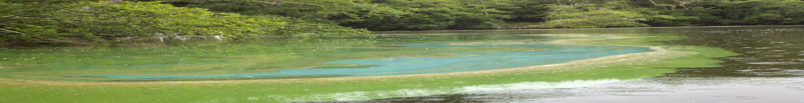
Cyanobacteria outcompete
First organism to produce O2 (via photosynthesis) and fix N
Long evolution (2.7 billion yrs) produced diverse and highly effective ecophisiological adaptations and strategies1
  Ensures survival/dominance during natural/human-induced changes
Can grow in depleted dissolved O2 environments detrimental or fatal to aerobic organisms2
Thrive in inhospitable places: hot springs, under ice packs, under rocks in deserts
  One of first organisms to colonize bare rock and soil
  Big advantage after long periods of drought

Slide 3
Cyanobacteria outcompete
Well adapted to environmental stress2
  Exposure to UV
  High solar radiation
  Extreme temperatures
  High pH
  Scarce and abundant nutrients
Photosynthesis increases pH giving cyanos an edge
Can regulate buoyancy for optimal light and nutrients
  Can store P for use when levels are limited
  Highly toxic strains outcompete toxic/non-toxic strains
    Ex: Upper K-Falls Lake (AFA to microcystis)
  Competitive advantage increases likelihood of HAB events

Slide 4
Cyanobacteria can survive drought & CC
During very dry summers N becomes the limiting nutrient
  N fixers will survive and release N for other non-N fixers
  CC enhances probability of toxic cyano dominance
  Factors promoting survivability/dominance of cyanos3
­­Temperature...Causes warming of surface water…
  Increases frequency/strength/duration of thermal stratification – mixing stops – O2/nutrients restricted to surface – no vertical movement
  Cyanos move through water column for optimal food/conditions-others cannot
  reduced viscosity increases speed of vertical migration of cyanos - competitive advantage over large bacteria that can’t migrate
  Cyano blooms increase water temp, further favoring HAB growth
Notes:
Thermal stratification – when warm surface water prevents mixing and O2 and nutrients cannot move up and down in water column

Slide 5
Cyanobacteria can survive drought & CC
Decreased water flows – Causes increased salinity…
  Cyanos quite salt tolerant
  Creates favorable conditions for invasion of marine HABs
  Happening in US SW and SC regions – fish kills in inland waters (since 2000)
Increase in carbon dioxide – Atmospheric and dissolved…
  Cyanos can pull CO2 directly from air when they float to surface
  Greater access to CO2 for growth increases occurrence of blooms
  Competition & shading kills other biota
Increased photosynthesis – Causes increased acidification…
  Cyanos like pH over 6.9 – helps them outcompete algae
  Harder for zooplankton to control through grazing (too many to eat)

Slide 6

Cyanobacteria can survive drought & CC
Increase in extreme weather events…
Intense storms=Concentrated rainfall - Then long dry periods
  Increased transport of nutrients from land to water via runoff
  Drought increases length of time water can retain nutrients
    More nutirents and longer retention time = More food for longer periods = Increase blooms and densities
Sea Level Rise…Increased extent of continental shelves
  Provides shallow, stable water favoring blooms
  Could expand cyanos habitat inland causing emerging issues

Slide 7
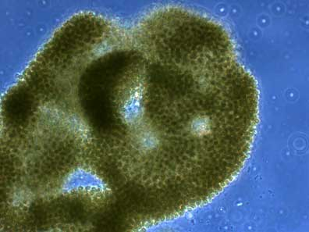
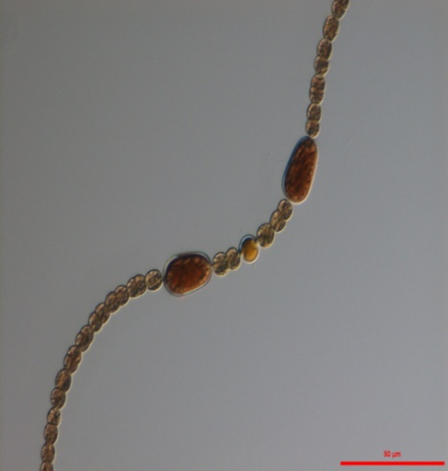
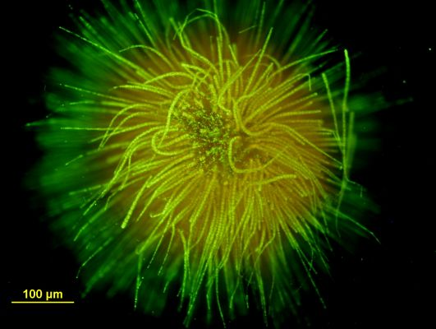
Major genus of cyanobacteria in Oregon
Diverse group of aquatic, photosynthetic bacteria (not algae!)
Microcystis: Non N fixer – Very hardy
Produces micocystin and anatoxin-a
Dolichospermum: N fixing heterocysts
Produces Microcystin, anatoxin-a + 2
Aphanizomenon: N fixing heterocysts
Non-toxin producer in Oregon
Gleotrichia: N fixing (has 1 large heterocyst)
Produces microcystin

Slide 8
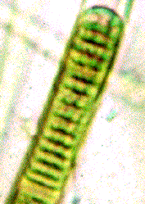
2009-2015: Cell count data
4 toxins
2 toxins
No toxins-Yet
2 toxins
Number of times genera of cyanobacteria identified over cell count guideline values (GV) during advisories in monitored waterbodies.
Notes:
Dolichospermum is the most identified genera of cynobacteria during advisories
Can live in a wide range of water temps and salinities
Cannot survive high light intensities over long periods
Grow in number when chains begin to fragment. Each fragment then grows another piece (like worms do!)
Microcystis aeruginosa is most common cyanobacteria worldwide
Likes low salinity water
Can survive high light intensities over long periods by regulating buoyancy

Slide 9
2009-2015: Toxin data
Number of times identified
Number of times cyanotoxins identified over recreational GVs during advisories in monitored waterbodies - GVs dependent upon genera

Slide 10
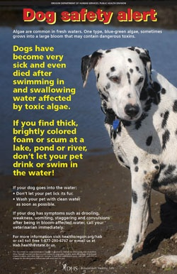
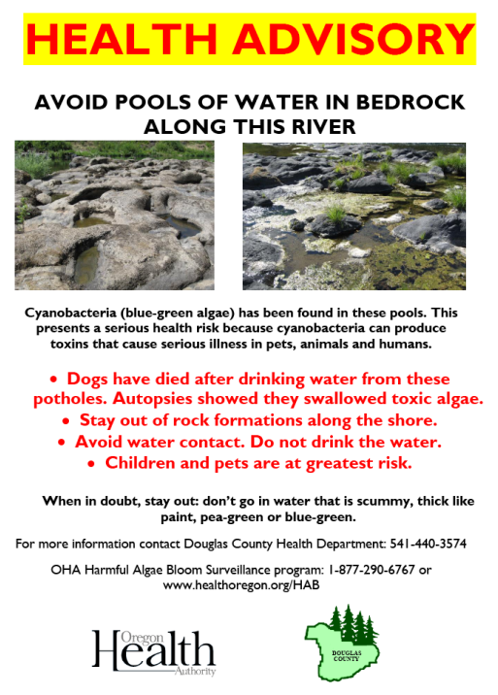
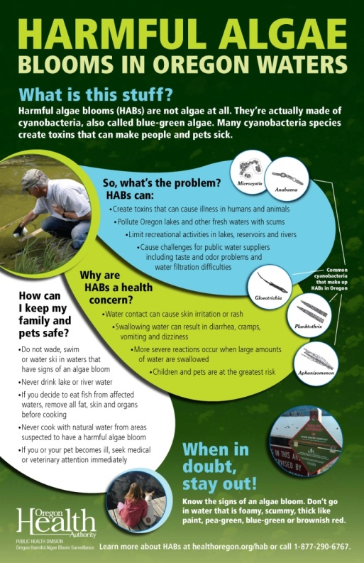
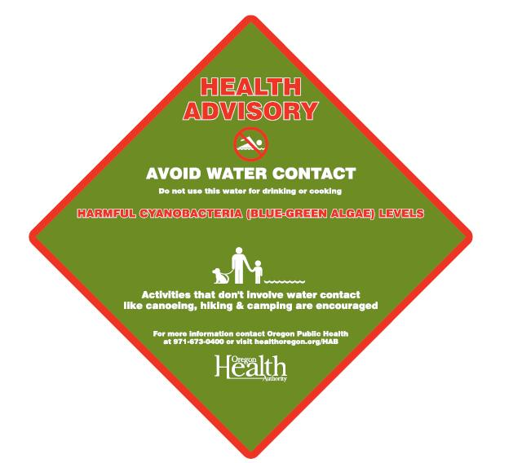
Public health advisory notification and outreach
E-mail alerts/Gov-Delivery messages sent
    DMAs/local HDs/DEQ/stakeholders/public
News release issued
    Posted on PHD/OHA websites
Social media tools (e.g.- Twitter)
Toll-free information line updated
    877-290-6767
Program website/map updated
    http://www.healthoregon.org/hab
Advisory signs posted
Calls from public and
media addressed
Notes:
10

Slide 11

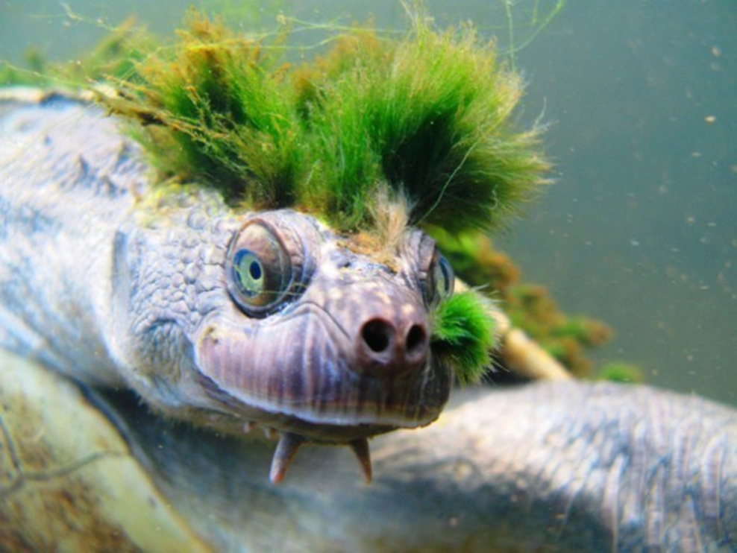
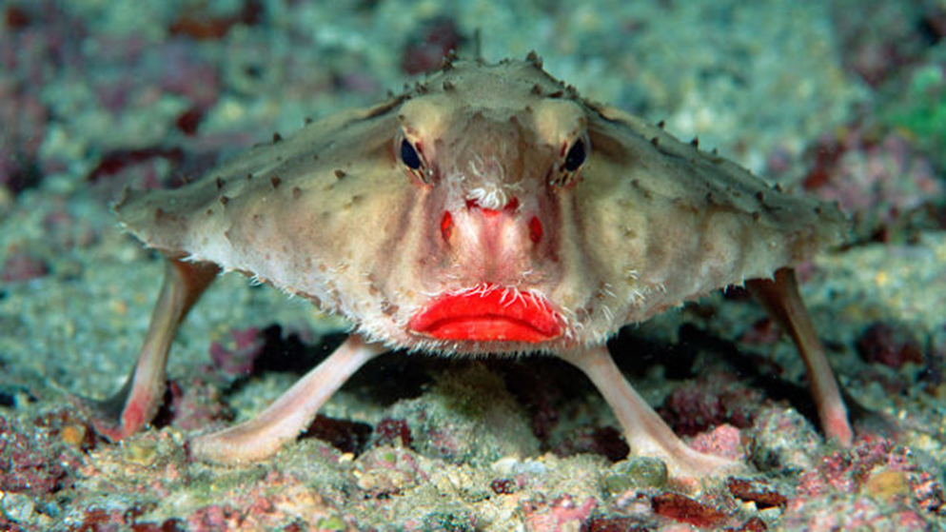
Breaking news story:
Chronic exposures revealed
Now, photographic evidence of the side affects of chronic cyanotoxin exposure
Freshwater cyanotoxins
Marine cyanotoxins
www.healthoregon.org/hab
Rebecca Hillwig – rebecca.hillwig@state.or.us
David Farrer – david.g.farrer@state.or.us

